Slide 1
Intervention Trigger I(t) = 0.0182

Slide 2
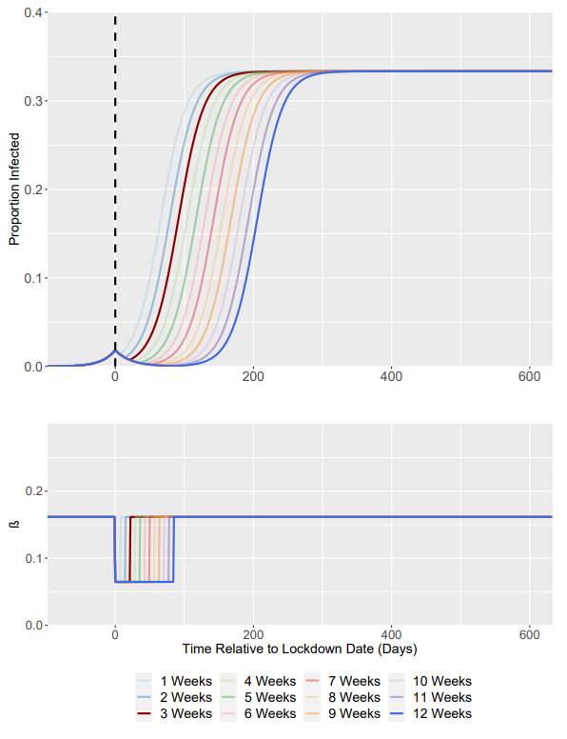
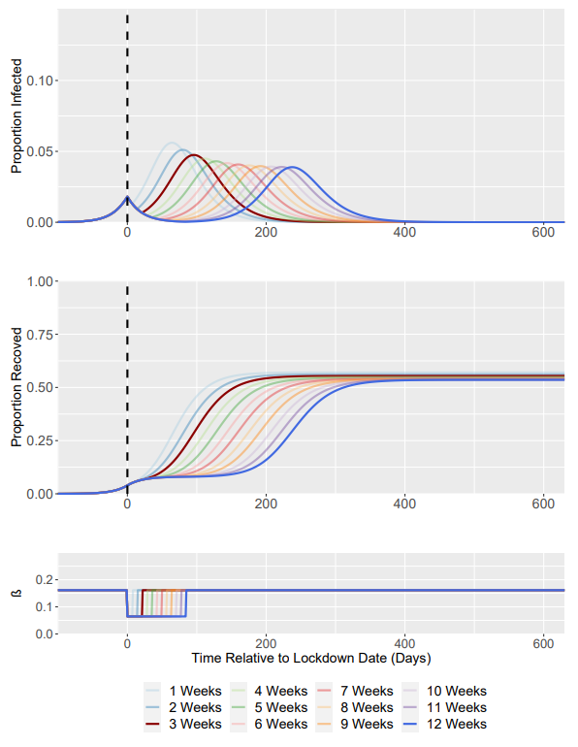
Baseline Scenario: Intervention Analysis Weeks 1-12
SIS Model
SIR Model
R₀ = 1.5 -> R₀ = 0.6
Weeks correspond to length of intervention
Highlighted (less transparent) lines correspond to Week 3 and Week 12
Dashed Line Represents Time of Intervention Start

Slide 3
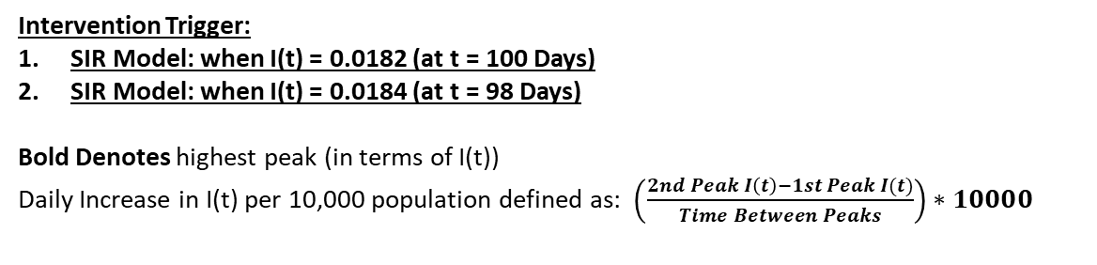
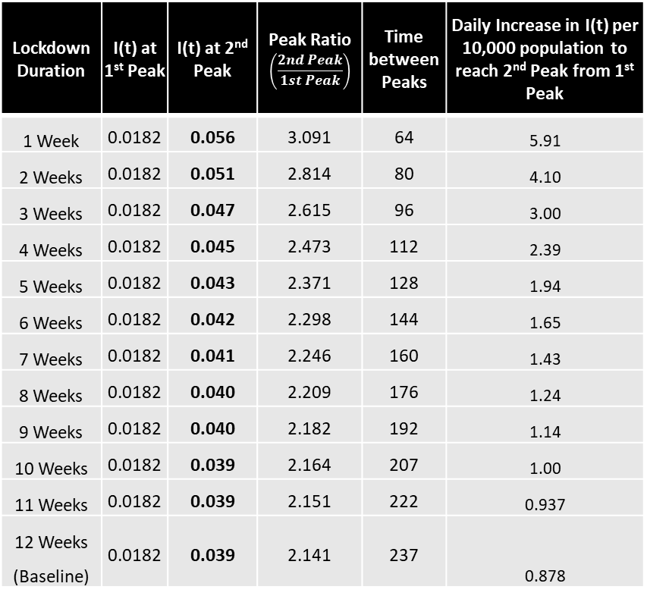
Intervention Trigger:
SIR Model: when I(t) = 0.0182 (at t = 100 Days)
SIR Model: when I(t) = 0.0184 (at t = 98 Days)
Bold Denotes highest peak (in terms of I(t))
Daily Increase in I(t) per 10,000 population defined as: $\left(\frac{2nd Peak I\left(t\right)−1st Peak I(t)}{Time Between Peaks}\right)∗10000$
Time till slope fall-off is the time between the first trigger point (t) and point (t’), the “slope fall off” point, where the slope of the line between (t,I(t)) and (t’,I(t’)) is equal or bigger than dI/dt at t’ (with t’ > t).
i.e - Where the line touches the curve only once!
SIR Model Summary Table
SIS Model Summary Table
Lockdown Duration | I(t) at 1st Peak | I(t) at 2nd Peak | Peak Ratio $$\left(\frac{2nd Peak}{1st Peak}\right)$$ | Time between Peaks | Daily Increase in I(t) per 10,000 population to reach 2nd Peak from 1st Peak
1 Week | 0.0182 | 0.056 | 3.091 | 64 | 5.91
2 Weeks | 0.0182 | 0.051 | 2.814 | 80 | 4.10
3 Weeks | 0.0182 | 0.047 | 2.615 | 96 | 3.00
4 Weeks | 0.0182 | 0.045 | 2.473 | 112 | 2.39
5 Weeks | 0.0182 | 0.043 | 2.371 | 128 | 1.94
6 Weeks | 0.0182 | 0.042 | 2.298 | 144 | 1.65
7 Weeks | 0.0182 | 0.041 | 2.246 | 160 | 1.43
8 Weeks | 0.0182 | 0.040 | 2.209 | 176 | 1.24
9 Weeks | 0.0182 | 0.040 | 2.182 | 192 | 1.14
10 Weeks | 0.0182 | 0.039 | 2.164 | 207 | 1.00
11 Weeks | 0.0182 | 0.039 | 2.151 | 222 | 0.937
12 Weeks (Baseline) | 0.0182 | 0.039 | 2.141 | 237 | 0.878
Lockdown Duration | I(t) at 1st Peak | I(t’) at “Slope fall off” | Time from 1st Peak to “Slope fall-off” | Daily Increase in I(t) per 10,000 population to reach “Slope fall off” from 1st Peak
1 Week | 0.0184 | 0.271 | 93 | 27.16
2 Weeks | 0.0184 | 0.281 | 110 | 23.87
3 Weeks | 0.0184 | 0.288 | 126 | 21.40
4 Weeks | 0.0184 | 0.293 | 141 | 19.48
5 Weeks | 0.0184 | 0.295 | 155 | 17.85
6 Weeks | 0.0184 | 0.299 | 170 | 16.51
7 Weeks | 0.0184 | 0.301 | 184 | 15.36
8 Weeks | 0.0184 | 0.303 | 198 | 14.37
9 Weeks | 0.0184 | 0.305 | 212 | 13.52
10 Weeks | 0.0184 | 0.307 | 226 | 12.77
11 Weeks | 0.0184 | 0.309 | 240 | 12.11
12 Weeks (Baseline) | 0.0184 | 0.310 | 254 | 11.48

Slide 4
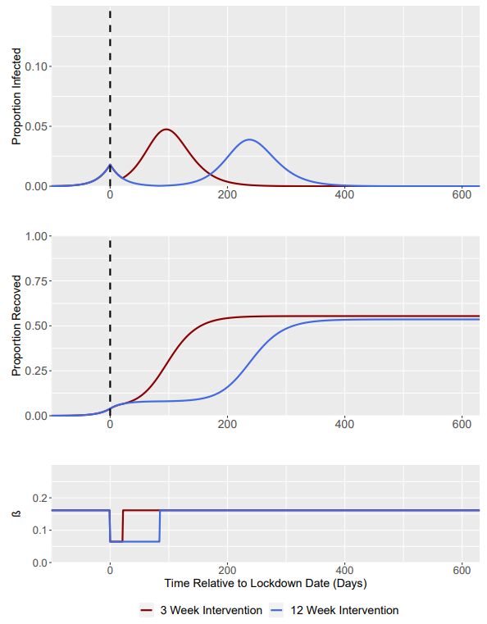
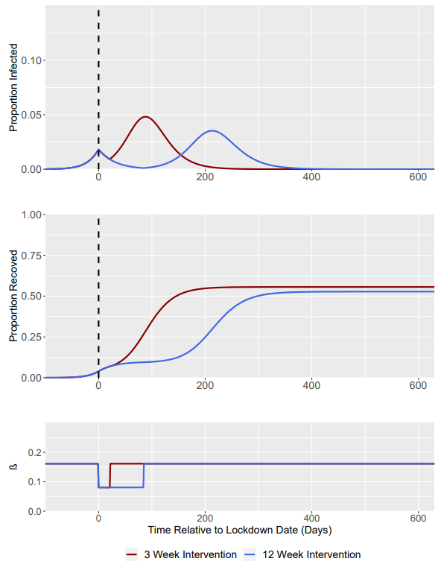
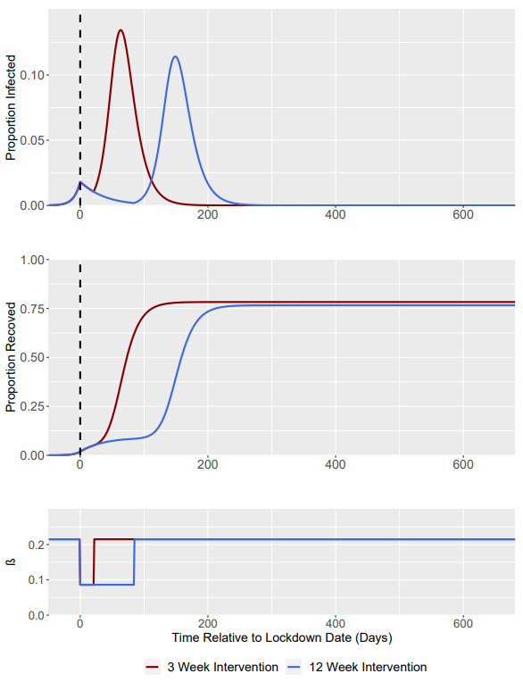
R₀ = 1.5 -> R₀ = 0.6 (Baseline)
R₀ = 1.5 -> R₀ = 0.75
R₀ = 2.0 -> R₀ = 0.8
Dashed Line Represents Time of Intervention Start

Slide 5
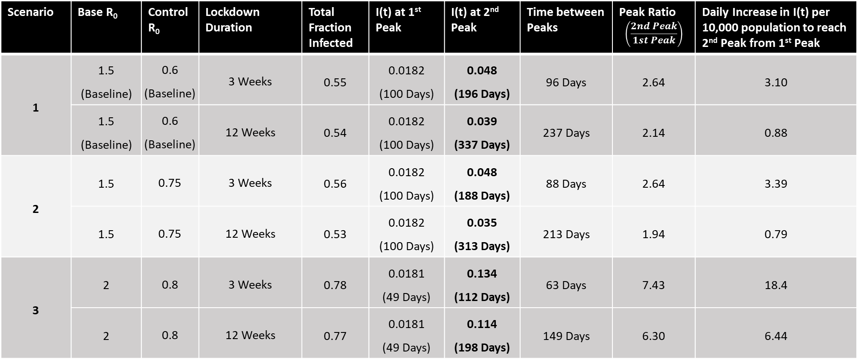
Intervention Trigger = when I(t) = 0.0182 (at t = 100 Days for Scenario 1 + 2; at t = 49 for Scenario 3)
Bold Denotes highest peak (in terms of I(t))
Scenario | Base R₀ | Control R₀ | Lockdown Duration | Total Fraction Infected | I(t) at 1st Peak | I(t) at 2nd Peak | Time between Peaks | Peak Ratio $$\left(\frac{2nd Peak}{1st Peak}\right)$$ | Daily Increase in I(t) per 10,000 population to reach 2nd Peak from 1st Peak
1 | 1.5 (Baseline) | 0.6 (Baseline) | 3 Weeks | 0.55 | 0.0182 (100 Days) | 0.048 (196 Days) | 96 Days | 2.64 | 3.10
 | 1.5 (Baseline) | 0.6 (Baseline) | 12 Weeks | 0.54 | 0.0182 (100 Days) | 0.039 (337 Days) | 237 Days | 2.14 | 0.88
2 | 1.5 | 0.75 | 3 Weeks | 0.56 | 0.0182 (100 Days) | 0.048 (188 Days) | 88 Days | 2.64 | 3.39
 | 1.5 | 0.75 | 12 Weeks | 0.53 | 0.0182 (100 Days) | 0.035 (313 Days) | 213 Days | 1.94 | 0.79
3 | 2 | 0.8 | 3 Weeks | 0.78 | 0.0181 (49 Days) | 0.134 (112 Days) | 63 Days | 7.43 | 18.4
 | 2 | 0.8 | 12 Weeks | 0.77 | 0.0181 (49 Days) | 0.114 (198 Days) | 149 Days | 6.30 | 6.44
Daily Increase in I(t) per 10,000 population defined as: $\left(\frac{2nd Peak I\left(t\right)−1st Peak I(t)}{Time Between Peaks}\right)∗10000$

Slide 6
Intervention Trigger I(t) = 0.0054

Slide 7
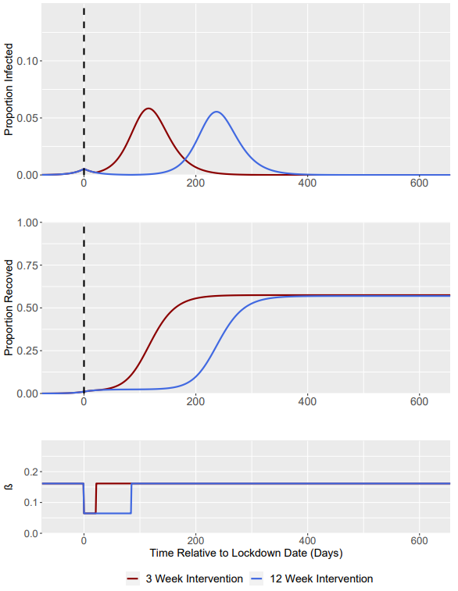
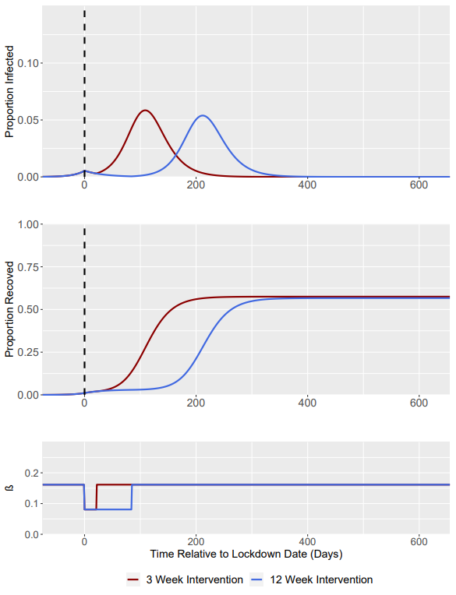
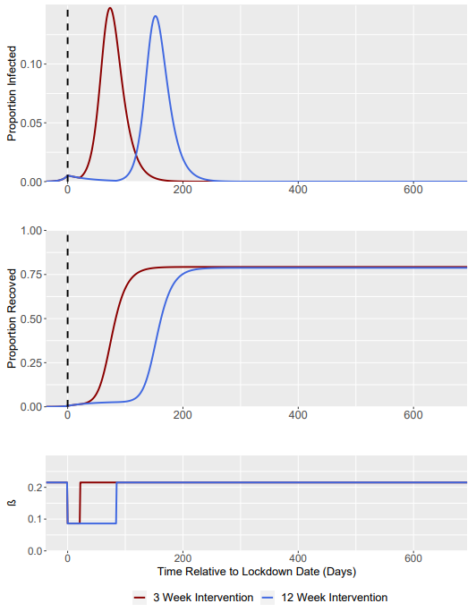
R₀ = 1.5 -> R₀ = 0.6 (Baseline)
R₀ = 1.5 -> R₀ = 0.75
R₀ = 2.0 -> R₀ = 0.8
Dashed Line Represents Time of Intervention Start

Slide 8

Intervention Trigger = when I(t) = 0.0054 (at t = 75 Days for scenario 1 + 2; at t = 37 Days for scenario 3)
Bold Denotes highest peak (in terms of I(t))
Scenario | Base R₀ | Control R₀ | Lockdown Duration | Total Fraction Infected | I(t) at 1st Peak | I(t) at 2nd Peak | Time between Peaks | Peak Ratio $$\left(\frac{2nd Peak}{1st Peak}\right)$$ | Daily Increase in I(t) per 10,000 population to reach 2nd Peak from 1st Peak
1 | 1.5 (Baseline) | 0.6 (Baseline) | 3 Weeks | 0.58 | 0.0054 (75 Days) | 0.058 (190 Days) | 115 Days | 10.8 | 4.57
 | 1.5 (Baseline) | 0.6 (Baseline) | 12 Weeks | 0.57 | 0.0054 (75 Days) | 0.055 (312 Days) | 237 Days | 10.3 | 2.09
2 | 1.5 | 0.75 | 3 Weeks | 0.58 | 0.0054 (75 Days) | 0.059 (184 Days) | 109 Days | 10.8 | 4.92
 | 1.5 | 0.75 | 12 Weeks | 0.57 | 0.0054 (75 Days) | 0.054 (Day 287) | 212 Days | 9.98 | 2.29
3 | 2 | 0.8 | 3 Weeks | 0.79 | 0.0053 (37 Days) | 0.148 (111 Days) | 74 Days | 27.9 | 19.2
 | 2 | 0.8 | 12 Weeks | 0.79 | 0.0053 (37 Days) | 0.141 (189 Days) | 152 Days | 26.6 | 8.93
Daily Increase in I(t) per 10,000 population defined as: $\left(\frac{2nd Peak I\left(t\right)−1st Peak I(t)}{Time Between Peaks}\right)∗10000$

Slide 9
Intervention Trigger I(t) = 0.0455

Slide 10
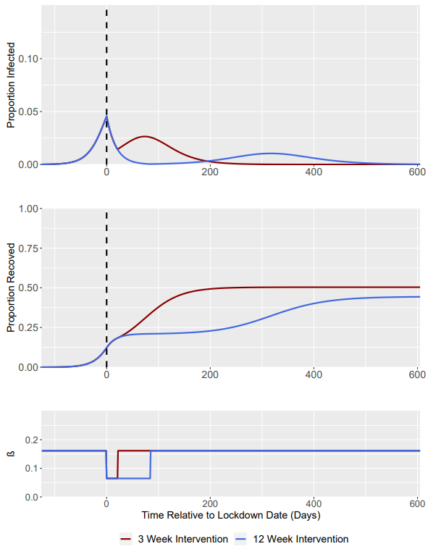
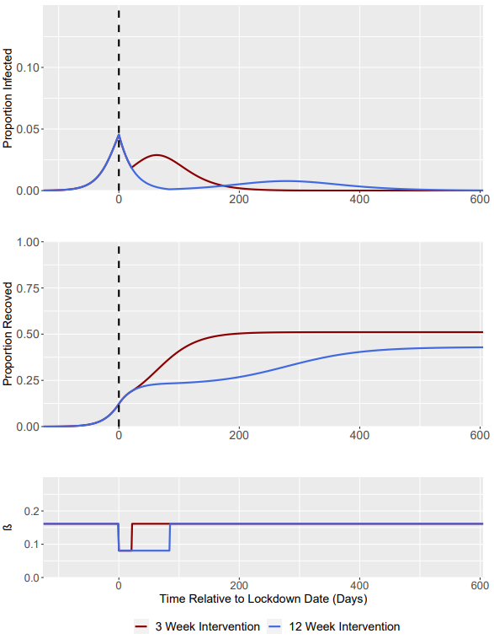
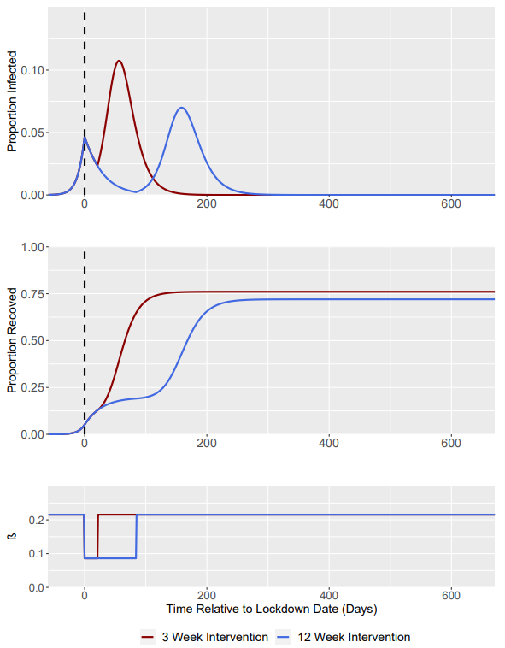
R₀ = 1.5 -> R₀ = 0.6 (Baseline)
R₀ = 1.5 -> R₀ = 0.75
R₀ = 2.0 -> R₀ = 0.8
Dashed Line Represents Time of Intervention Start

Slide 11
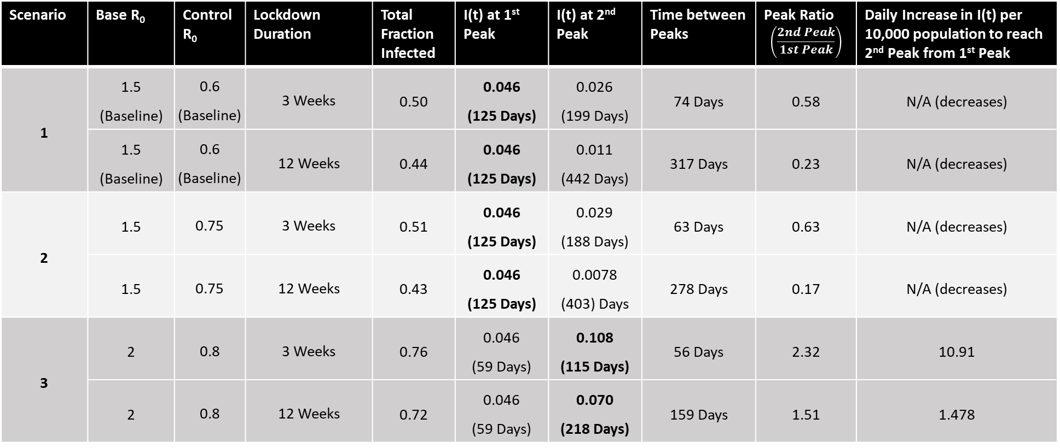
Intervention Trigger = when I(t) = 0.0455 (at t = 125 Days for scenario 1 + 2, at t = 59 Days for scenario 3)
Bold Denotes highest peak (in terms of I(t))
Scenario | Base R₀ | Control R₀ | Lockdown Duration | Total Fraction Infected | I(t) at 1st Peak | I(t) at 2nd Peak | Time between Peaks | Peak Ratio $$\left(\frac{2nd Peak}{1st Peak}\right)$$ | Daily Increase in I(t) per 10,000 population to reach 2nd Peak from 1st Peak
1 | 1.5 (Baseline) | 0.6 (Baseline) | 3 Weeks | 0.50 | 0.046 (125 Days) | 0.026 (199 Days) | 74 Days | 0.58 | N/A (decreases)
 | 1.5 (Baseline) | 0.6 (Baseline) | 12 Weeks | 0.44 | 0.046 (125 Days) | 0.011 (442 Days) | 317 Days | 0.23 | N/A (decreases)
2 | 1.5 | 0.75 | 3 Weeks | 0.51 | 0.046 (125 Days) | 0.029 (188 Days) | 63 Days | 0.63 | N/A (decreases)
 | 1.5 | 0.75 | 12 Weeks | 0.43 | 0.046 (125 Days) | 0.0078 (403) Days | 278 Days | 0.17 | N/A (decreases)
3 | 2 | 0.8 | 3 Weeks | 0.76 | 0.046 (59 Days) | 0.108 (115 Days) | 56 Days | 2.32 | 10.91
 | 2 | 0.8 | 12 Weeks | 0.72 | 0.046 (59 Days) | 0.070 (218 Days) | 159 Days | 1.51 | 1.478
Daily Increase in I(t) per 10,000 population defined as: $\left(\frac{2nd Peak I\left(t\right)−1st Peak I(t)}{Time Between Peaks}\right)∗10000$

